Slide 1


Slide 2
Quote of Wisdom
Expect the best, prepare for the worst.
– Quaid-e-Azam Mohammad Ali Jinnah (1876-1948, founder of the Islamic Republic of Pakistan)

Slide 3
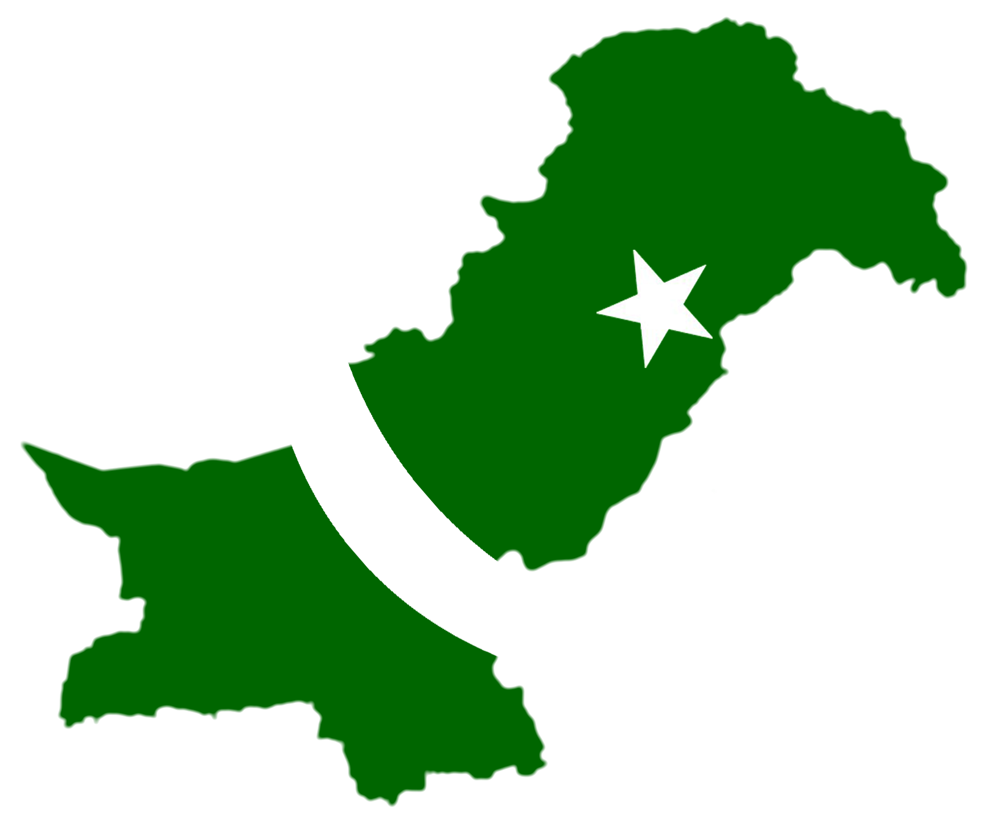
IDEOLOGY & CONSTITUTION OF PAKISTAN

Slide 4

Agenda for Today
Political developments in Sub-continent (1905 to 1919)

Slide 5

Developments: 1905-1919
Partition of Bengal (1905)
Simla Deputation (1906)
British Rule and Constitutional Reforms (1909)
Efforts for Hindu-Muslim Unity (1911-15); Quaid-e-Azam joins Muslim League
Mahatma Gandhi returns to India (1915)
Lucknow Pact (1916)
Khilafat Movement (1919)
-- continued

Slide 6
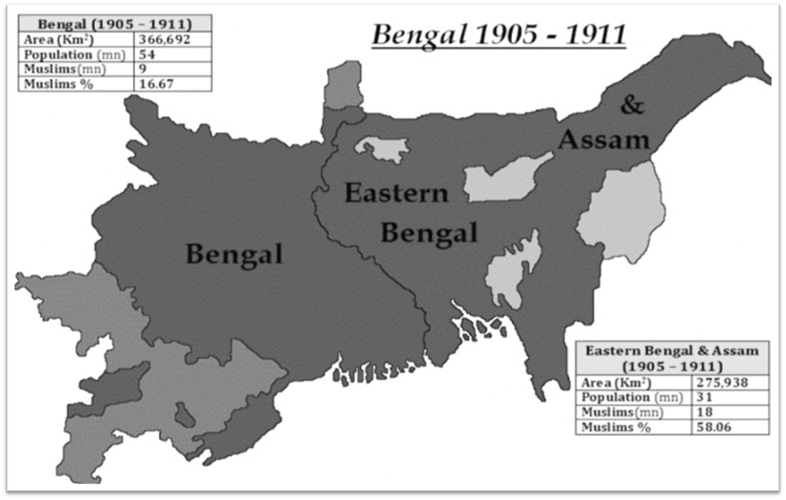
Partition of Bengal: 1905-11

Slide 7
All India Muslim League (1906)
Origin: At the annual Mohammadan Educational Conference (featuring Muslim leaders) at Dhaka in December 1906, a resolution was moved for establishing an organisation, called the All India Muslim League
The League became the most prominent platform to further the cause of Sub-continent Muslims' rights
Afterwards, the League's importance in the social and political struggle for Pakistan is widely acknowledged
Congress didn't like the formation of the Muslim League which weakened the Congress concept of 'Majority rule' in India, an idea rejected by Muslims
--continued

Slide 8
Aims of All India Muslim League
To promote among Indian Muslims feelings of loyalty to the British government
To safeguard and advance the political rights and interests of Indian Muslims, and convey their needs and aspirations to the government
To prevent any feeling of hostility among Muslims towards other communities of India (without jeopardising other aims of the League)

